Slide 1

Exploratory Data Analysis
Dec 12.2023
Health Care
Persistency Of Drugs
Report By : Mohamed Mohamed

Slide 2
Data summary
Total number of observations | 3424
Total number of files | 1
Total number of features | 69
Base format of the file | xlsx
Size of the data | 898 KB
Data & code location: Midohussien/Data-Science-Healthcare---Persistency-of-a-drug-: understanding the persistency of drug as per the physician prescription, and gather insights on the factors that are impacting the persistency, build a classification for the given dataset. (github.com)

Slide 3
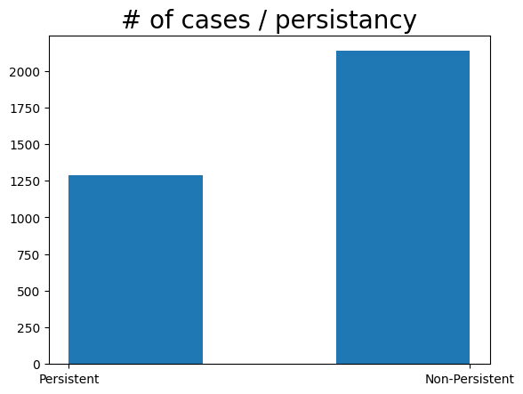
Data distribution

Slide 4
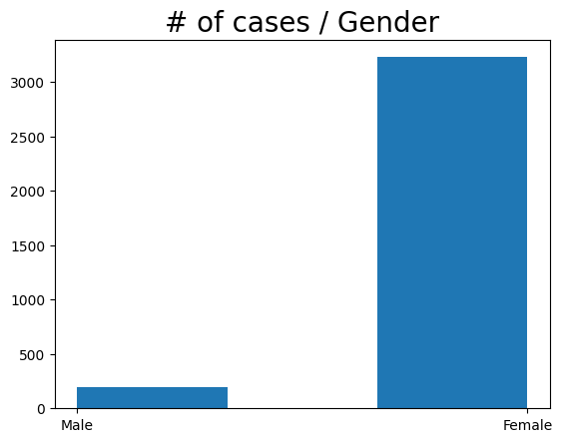
Data distribution

Slide 5
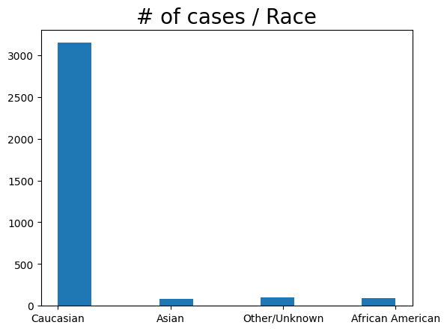
Data distribution

Slide 6
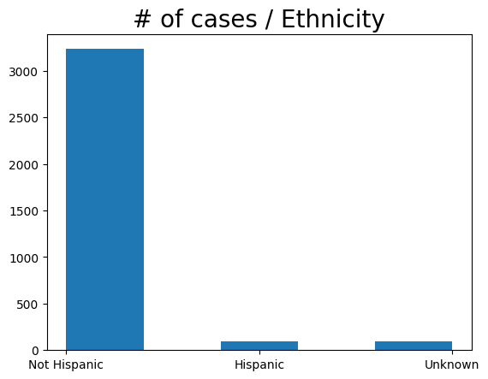
Data distribution

Slide 7
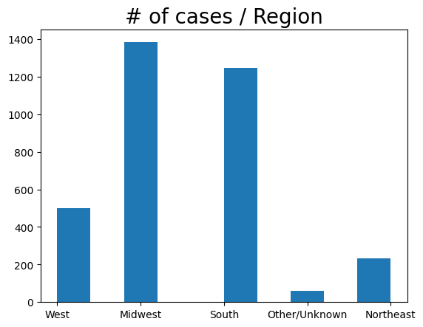
Data distribution

Slide 8
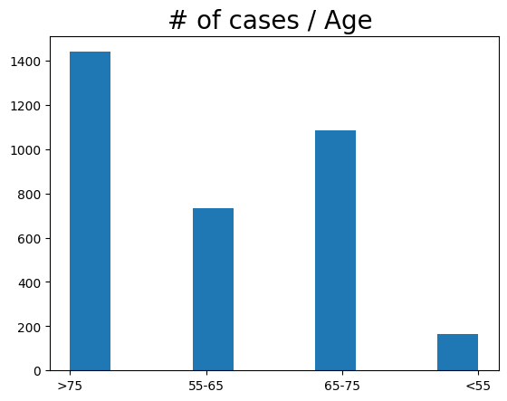
Data distribution

Slide 9
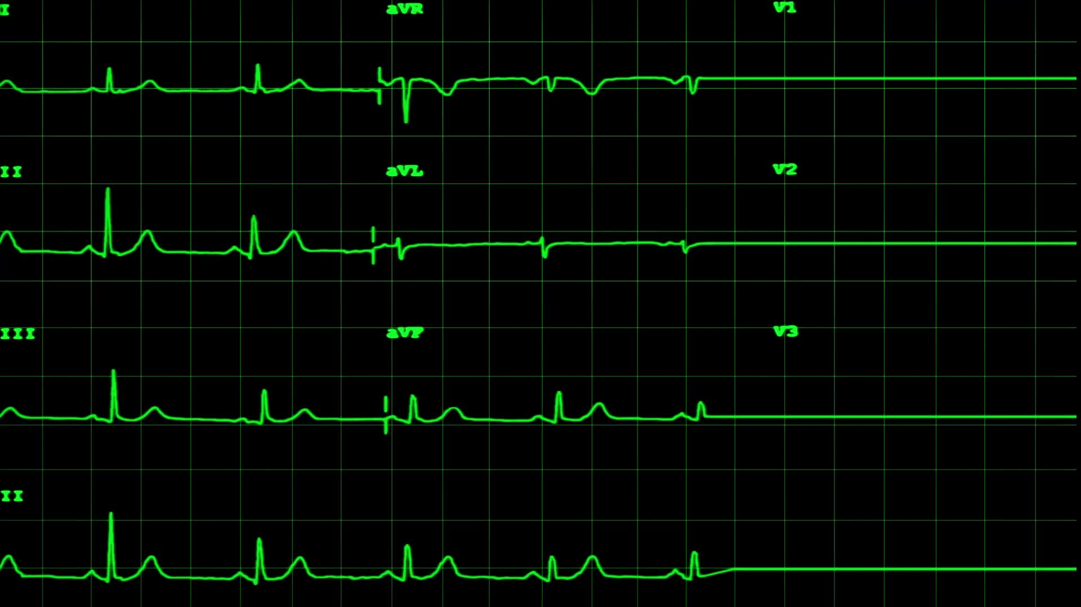
eda summary
The data in Drug_presistent.csv is tabular (2-dimensional).
The original data set has 3424 rows and 69 columns.
The total number of values was 236256.
There were no duplicate rows or missing values in the original data set.
all columns are object (string) data types, except two columns are numeric integer data
we have four races: Caucasian, Asian, Other/Unknown, or African American.
we have three different Ethnicity categories : Not Hispanic, Hispanic, or Unknown.
The patients were from 5 different regions : West, Midwest, South, Northeast, or Unknown.

Slide 10
eda summary
The patients were set in 4 different age categories : >75, 55-65, 65-75, or < 55.
The given data was imbalanced and skewed towards some categories:
1 - the number of non-persistent is highly more than the number of persistent.
2 - more than 90% of cases are females.
3 - more than 85% of cases are Caucasians.
4 - 85% of cases are non-Hispanic.
5 - most of the cases age are above 75 years.
All those reasons make the data imbalanced.

